Slide 1


MINISTERO DELL’ISTRUZIONE, DELLA RICERCA E DELL’UNIVERSITA’
UFFICIO SCOLASTICO REGIONALE PER IL LAZIO
ISTITUTO COMPRENSIVO “NETTUNO III”
18° CENTRO TERRITORIALE PERMANENTE ISTRUZIONE IN ETA’ ADULTA
Via OLMATA, 86 00048 NETTUNO 06 9881356 fax 06 98600505
 rmic8d2002@istruzione.it – rmic8d2002@pec.istruzione.it
www.icnettunotre.gov.it
CONCORSO
- LA SCUOLA PER EXPO 2015 -
Nutrire il Pianeta, Energia per la Vita.
LA CLASSE 3^{A} E DELL’ISTITUTO COMPRENSIVO “NETTUNO III”
Presenta:
“Dammi un Qui, dammi un No….Dammi un po’ di Quinoa”
COORDINATORE
PROF. CLAUDIO PERONCINI
DIRIGENTE SCOLASTICO
PROF.SSA ANNA MARIA CERVONI

Slide 2
QUINOA: our next challenge!
The class 3° E of the 3° Nettuno’s institute partecipated in the project “Feed the world, energy for life”, due to the teachers, who recognised the educational importance of this concourse. After many and long dibates we decided to enhance our knowledge about a specific kind of food, quinoa, due to the fact that the ONU and the FAO gave it a reward, defining it as “an ally with the fight against the starvation”.
This food caught our attention and, after a moment of uncertainty, we started discoverigng this special plant so often confused as a cereal.
Its nutritious properties make it probably the best foot nowadays, an excellent meal for those people who suffer from celiac disease, because it’s gluten free. It has olso a good taste and you can use it for many different courses, from your starter to your dessert. Anyway “fathom the flavour” has a great assonance…

Slide 3
…After researches and group works, we created: a DVD with an andean musical background that highlights the properties and the features of quinoa, recipes and drawings in different styles wich rapresent the EXPO, posters, pictures of the most important newspaper that advertise the product and spontaneous sketches.
The DVD is formed by our posters and by the pictures of a shopping bag designed and created by us to advertise the quinoa.
At the expo 2015 we’ll share our works,to focus the attention on the importance of quinoa like one of the possible solution to feed our planet,but especially to point out the elaborates of our classmate with a disability,he partecipated with us.
Moreover we would advertise our shopping bag that a sponsor reproduced in 500 copies.
The purpose is to focus the attention of the world on the role that quinoa plays in support of biodiversity, on its nutritional value,for the elimination of poverty.

Slide 4
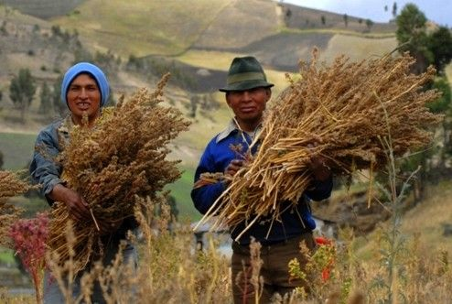
QUINOA

Slide 5
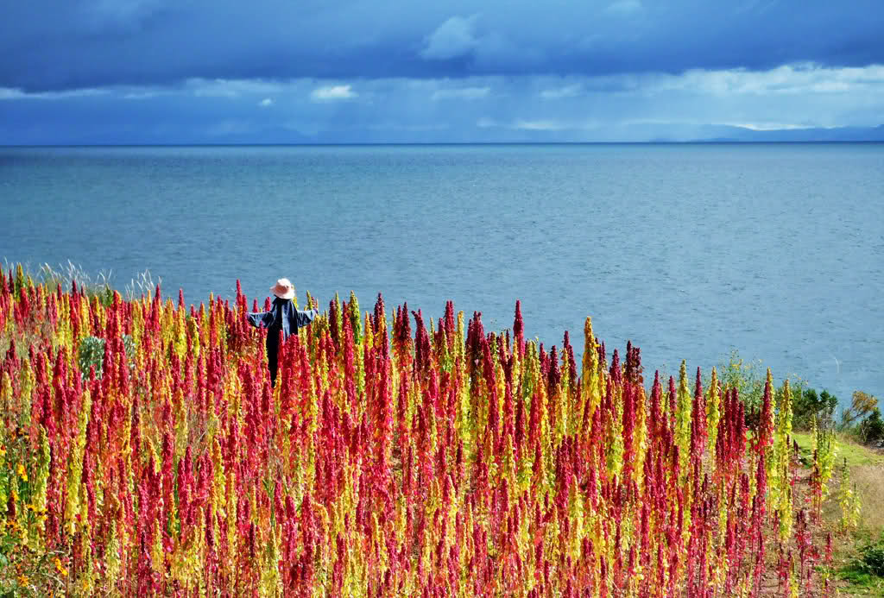
THE BIODIVERSITY
Mother Nature has provided us with many opportunities to feed the world with savage and cultivated products. Many scientific studies have shown that in the 350,000 known plant species in the history of mankind, there are at least 10,000 varieties of edible plants. but with each passing year this immense property of biodiversity is increasingly dispersed, infact for many families to put some food on the table has become a problem every day.
5
Notes:
5
LA SCUOLA PER EXPO 2015

Slide 6

2013: QUINOA’S YEAR!
2013 was declared, by F.A.O., Quinoa International Year. Quinoa plays an important rule for biodiversity, for its nutritional value and to eliminate poverty all around the world.

Slide 7
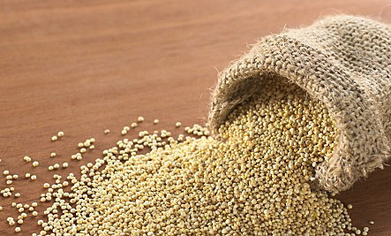
WHAT’S QUINOA ?
It's a plant classified like a false cereal. It produces a flour with amid. It's different from other cereals for its proteic power And becouse it's glutin free.Incas called it "chisiva mama" that means "mother of all seeds"

Slide 8
EFFECTS
BENEFITS
RELATING
HUMAN

Slide 9
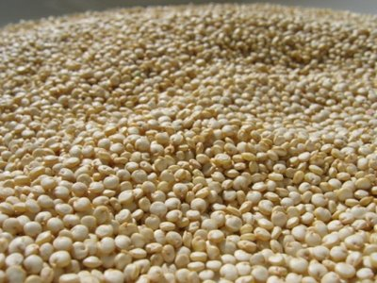
Vitamin B1 must be absorbed daily and is able to affect the nervous system and participate in the production of energy.
it is necessary to take vitamin C through feeding because the body is unable to synthesize it.
The carotene is essential for our body and it’s contained in orange foods.
VITAMINS
Vitamin B2 is essential for many metabolic functions, especially those relating to tissues.
Vitamin E is an anti-oxidant and anti-inflammatory.

Slide 10
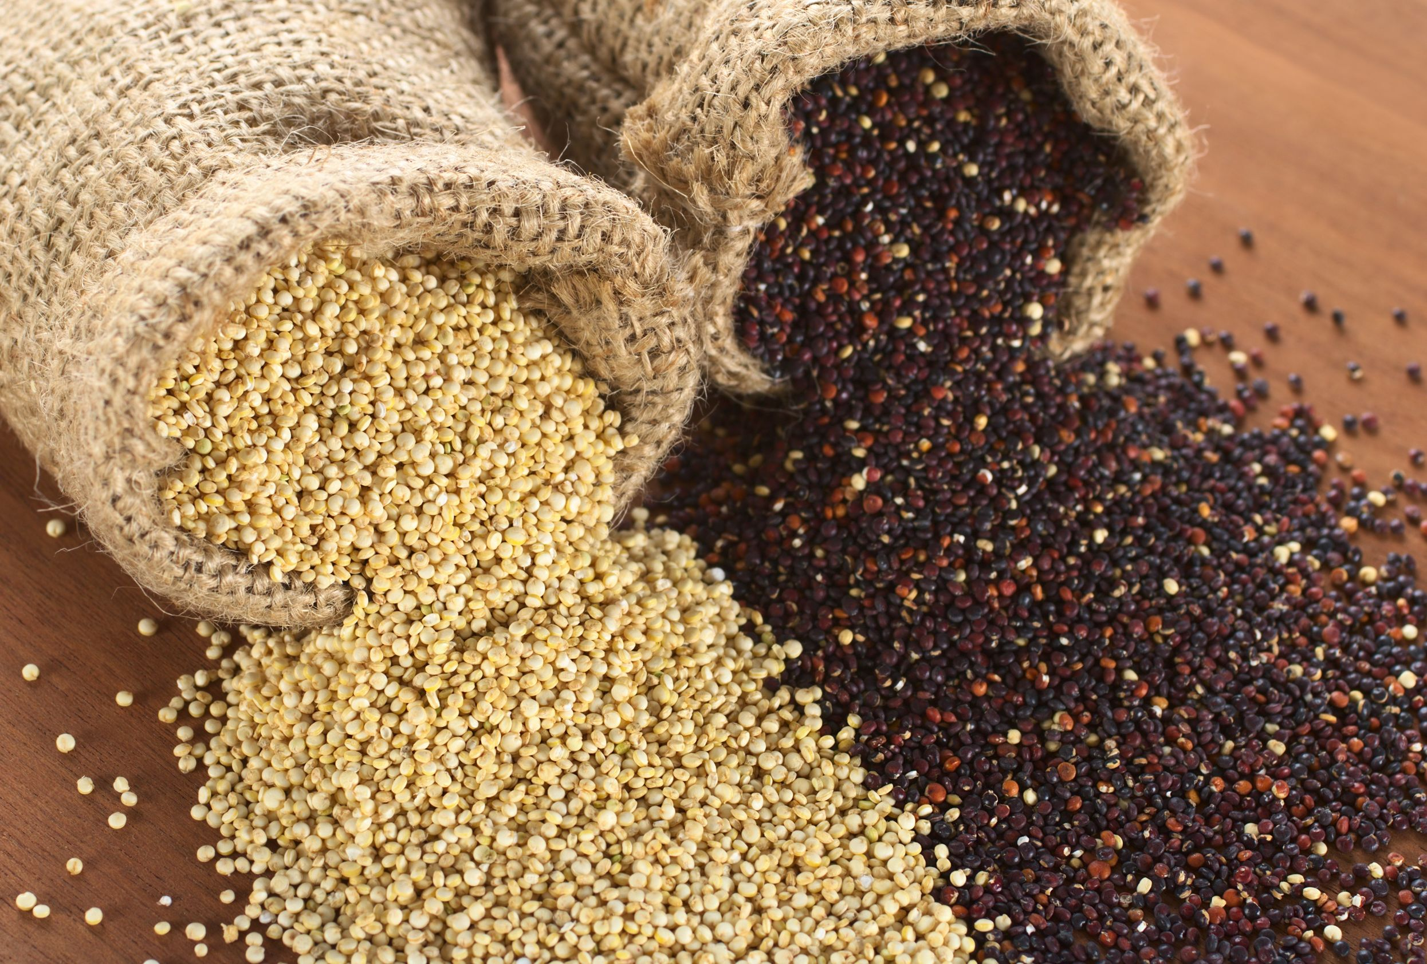
Histidine
Tryptophan
Cystine
Tyrosine
Threonine
Lysine
AMINO ACIDS
Damming
Methionine
Soleucine
Valine
Leucine

Slide 11
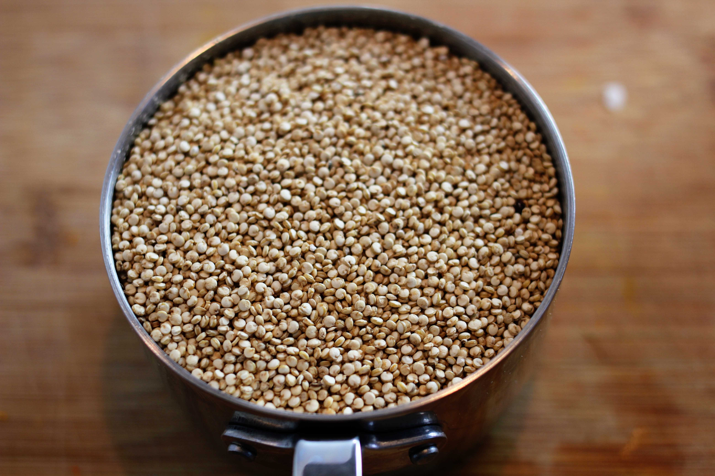
Phosphorus
Iron
Potassium
Calcium
Sodium
MINERALS
Sulfur
Magnesium
Zinc
Copper
Silicic acid
Chloride
Manganese

Slide 12
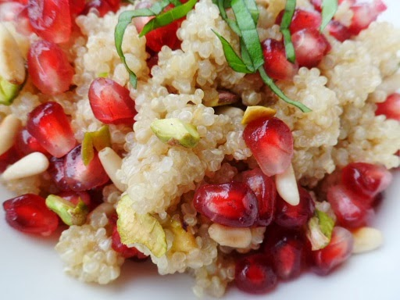
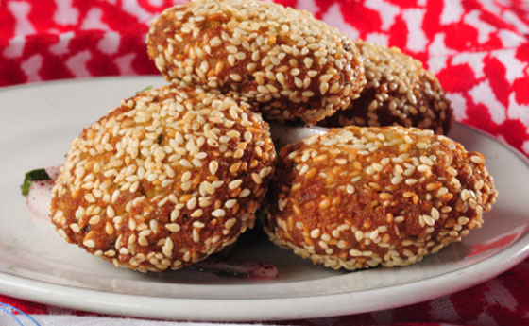
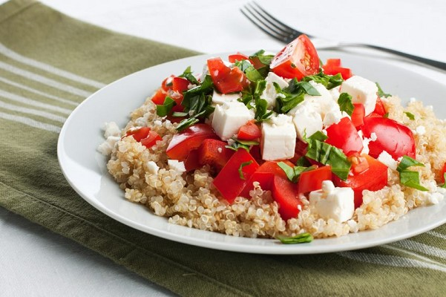
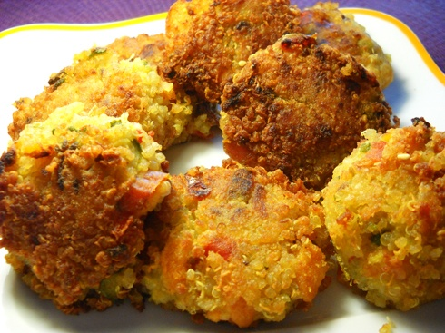
In the kitchen with
quinoa!

Slide 13
Quinoa with nuts and pomegranate
Toasted quinoa in a little oil for a few minutes stirring occasionally. Add salted water ,cover it with a damp cloth and leave it for about twenty minutes. Add apricots,raisins,pepper and the peel of citrus fruits,then put on the pomegranate seeds.

Slide 14
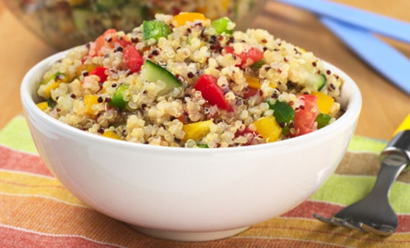
QUINOA WITH LEMON AND AVOCADO
Boil water in a pan, in the meantime put the quinoa in a pan whit a drizzle of olive oil and saute for a minute. Add the broth and cook for 15 minutes. Transfer the quinoa in a bowl and cut the cucumber ,radishes and dill. In another bowl put the lemon juice, two tablespoons of olive oil, pour the cooled quinoa and also add the grated lemon peel. Stir everything, served on plates and add the diced avocado

Slide 15
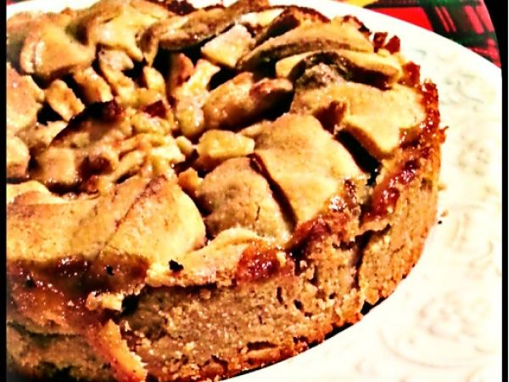
Apple pie with quinoa flour
Put the quinoa flour and normal flour in a pan and put them on low heat, stirring occasionally. Let toast just until the flour will take a nice golden color and a heavenly scent, then remove from heat, pour into a glass bowl and let cool. Add the sugar, the butter and the grated lemon, egg yolks and a tablespoon of milk, then mix quickly. Make a ball with the dough, put it in the plastic wrap and refrigerate for at least two hours. Roll out and put on jam, apple slices and sugar. Now , in the oven!

Slide 16
OUR
WORKS

Slide 17

CALAMAI

Slide 18
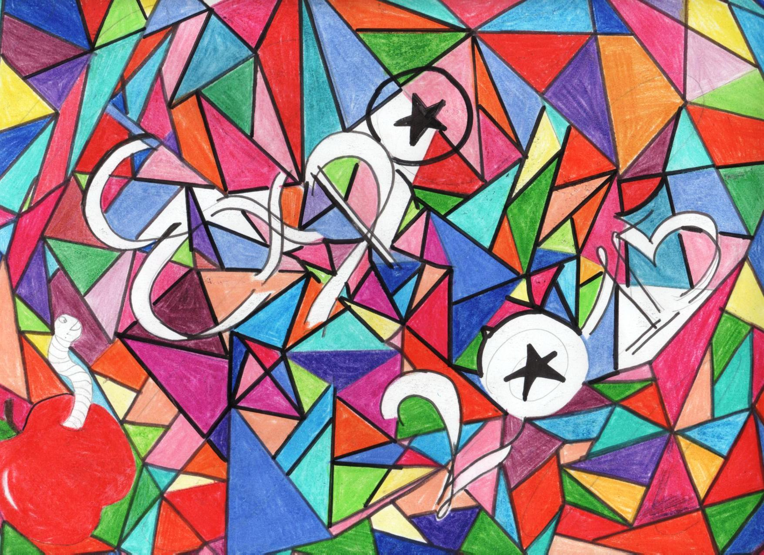
LUCHI

Slide 19

SOLDATI

Slide 20
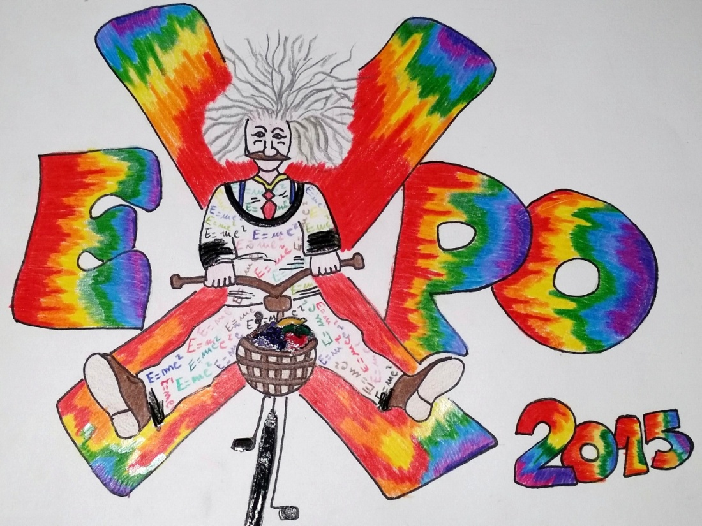
TAURELLI

Slide 21
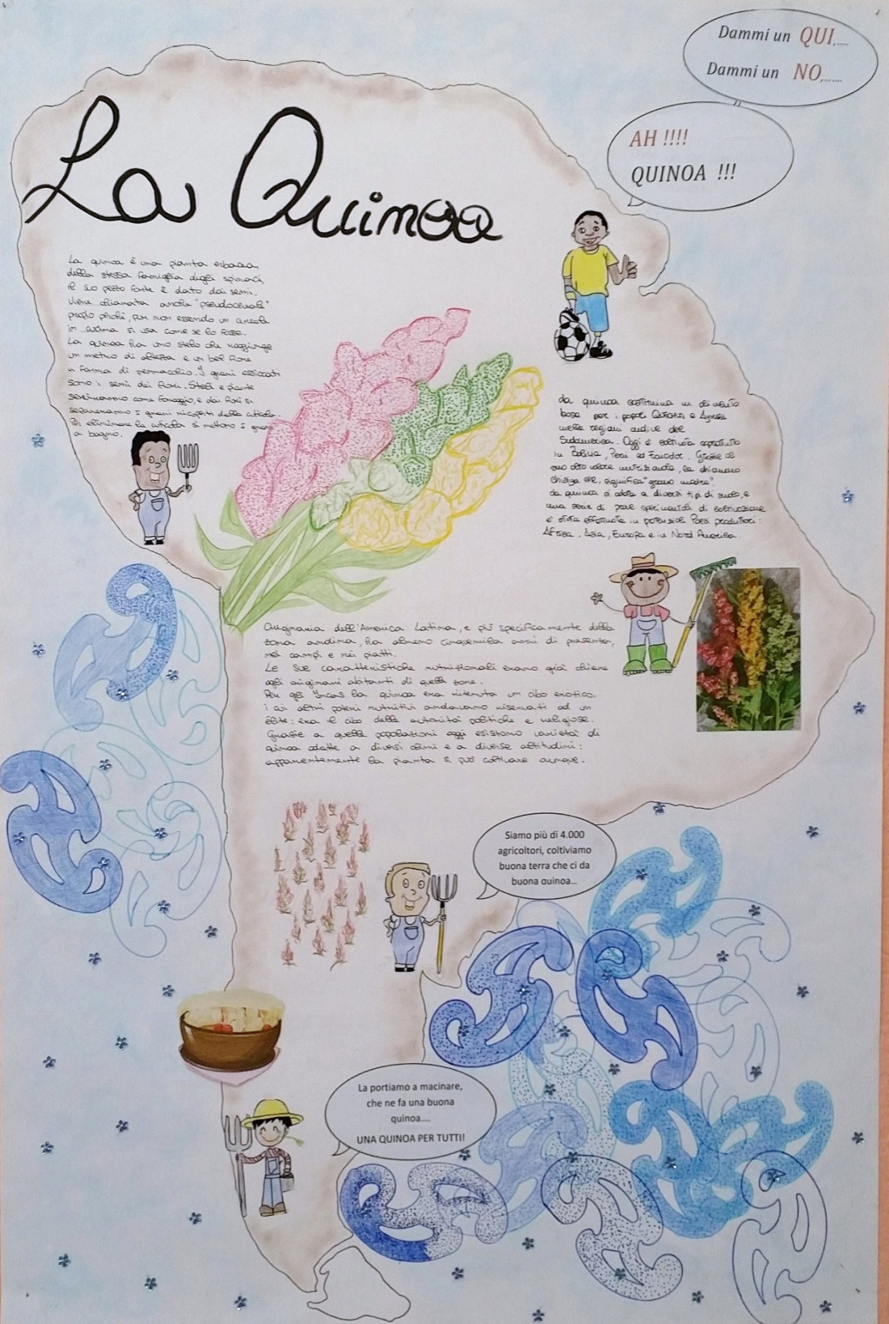

Slide 22

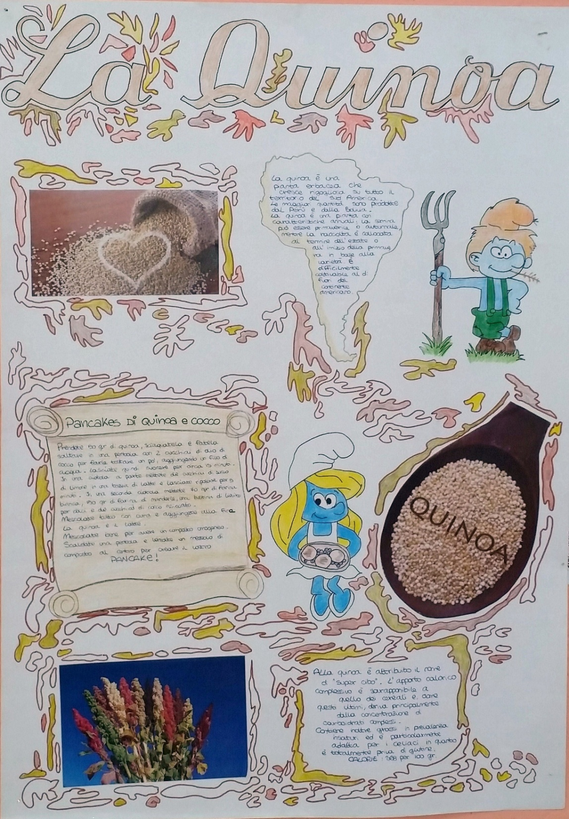

Slide 23
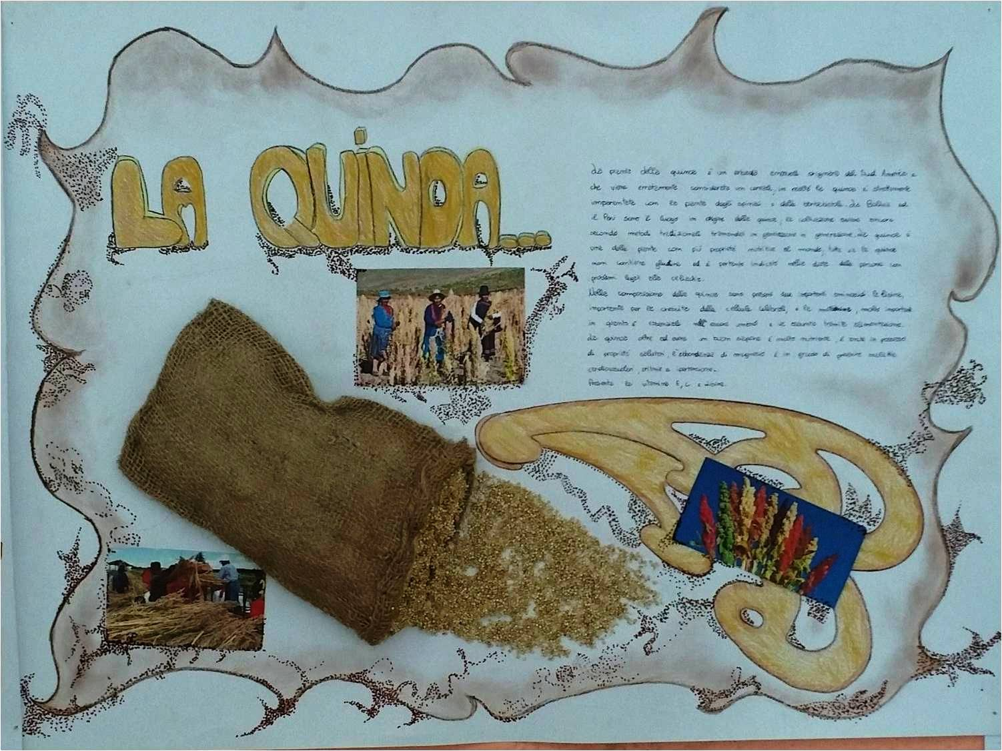

Slide 24
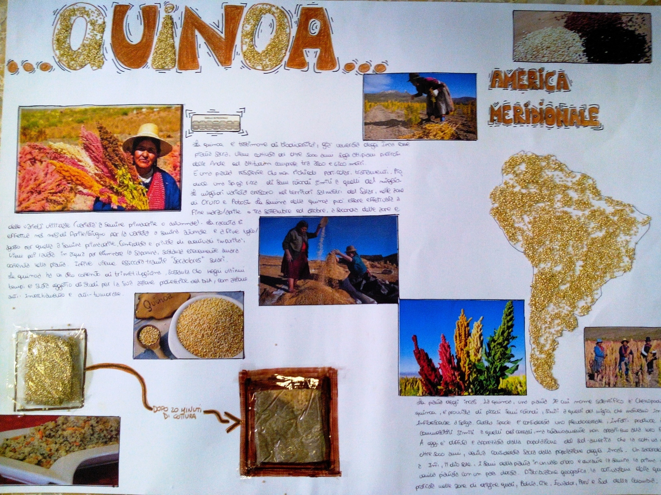

Slide 25
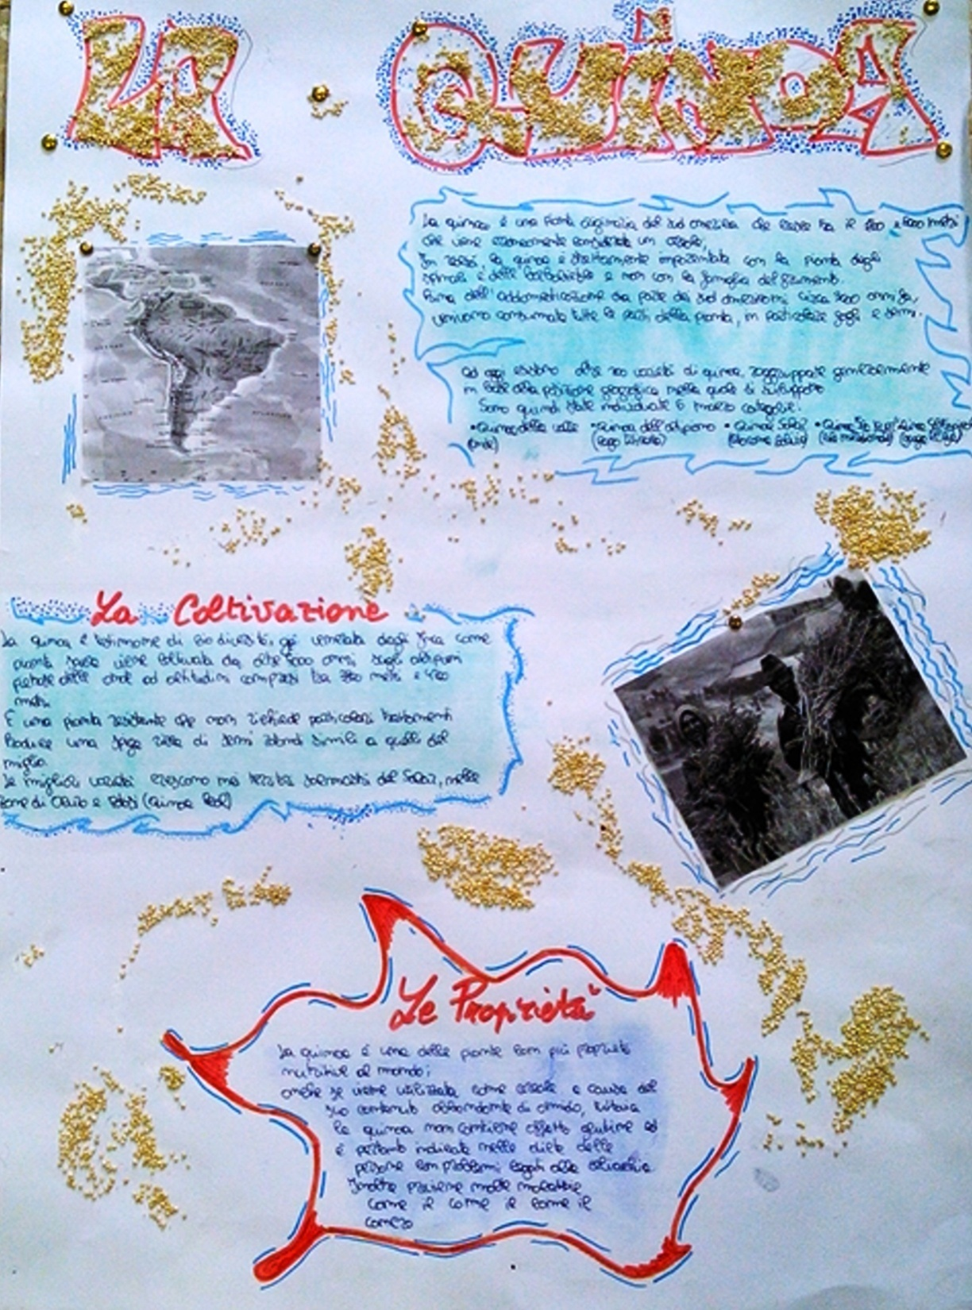

Slide 26
MAGAZINES
AND
NEWPAPERS………..

Slide 27
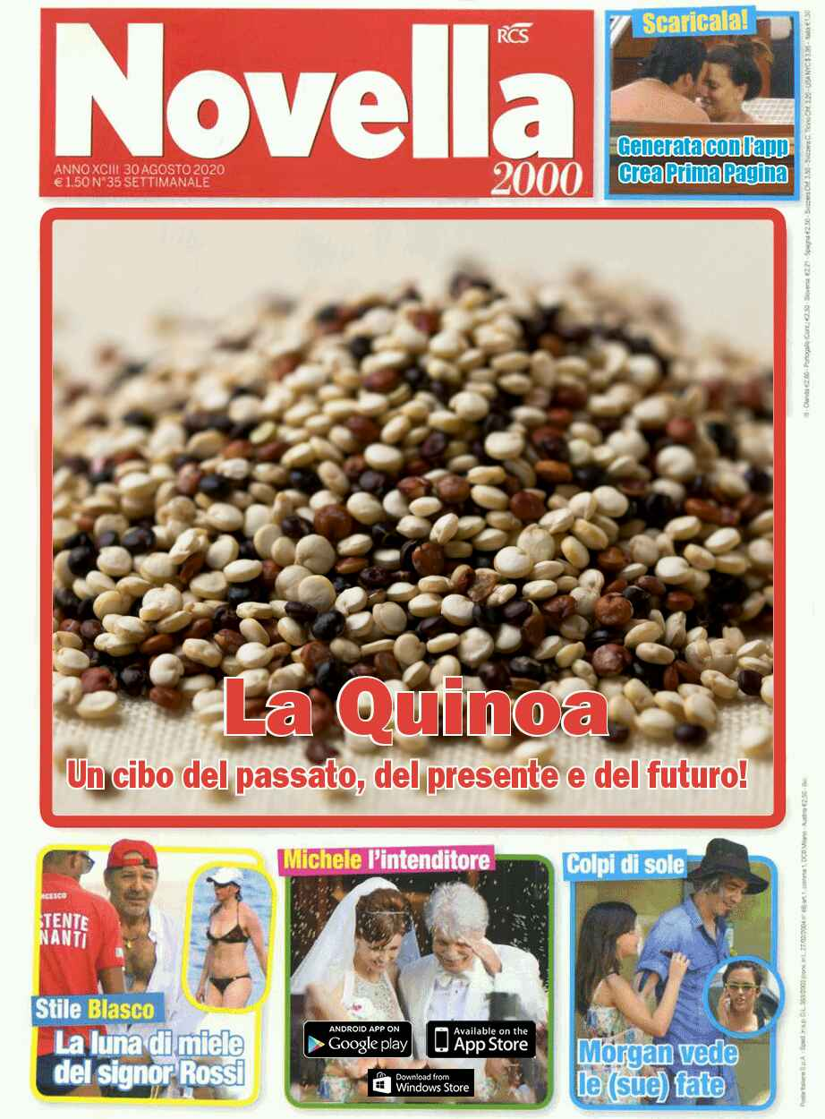

Slide 28
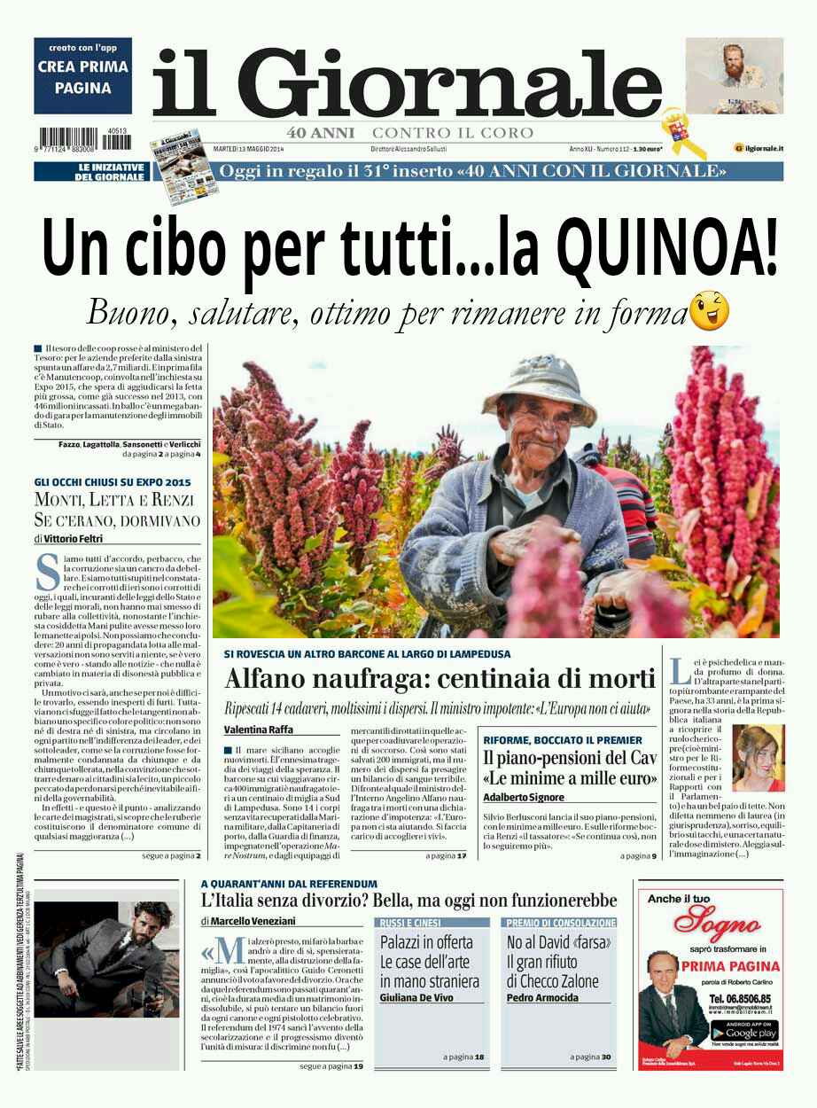

Slide 29
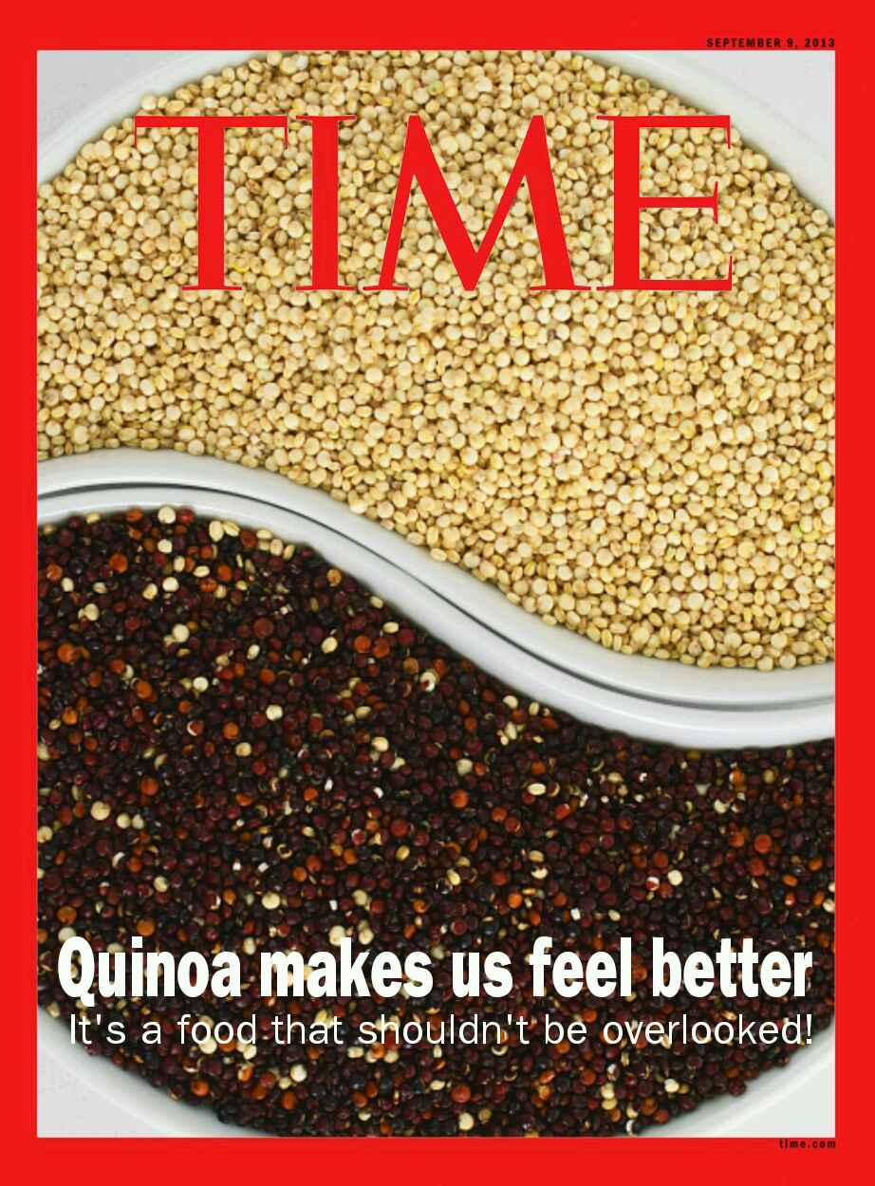

Slide 30
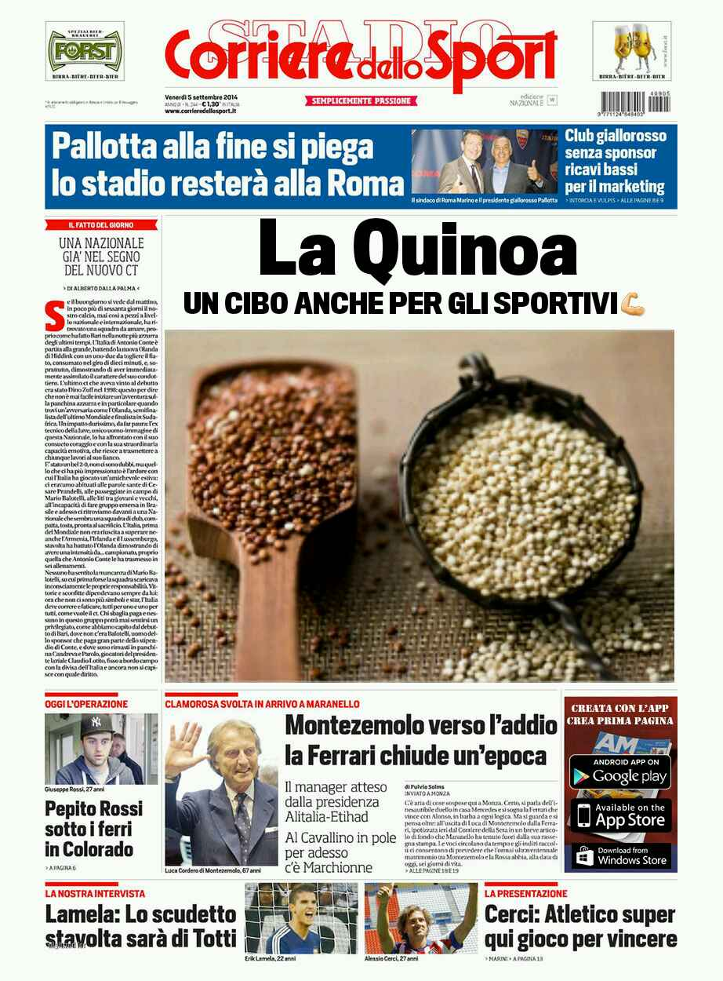

Slide 31
AND NOW….

Slide 32
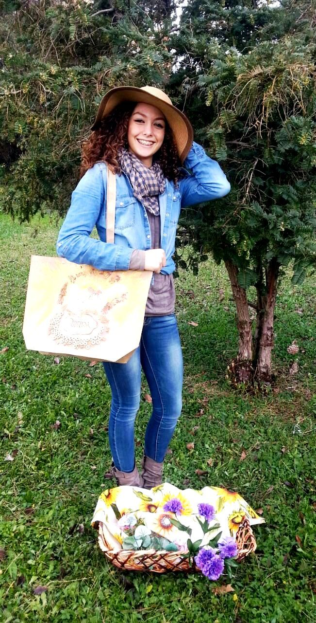
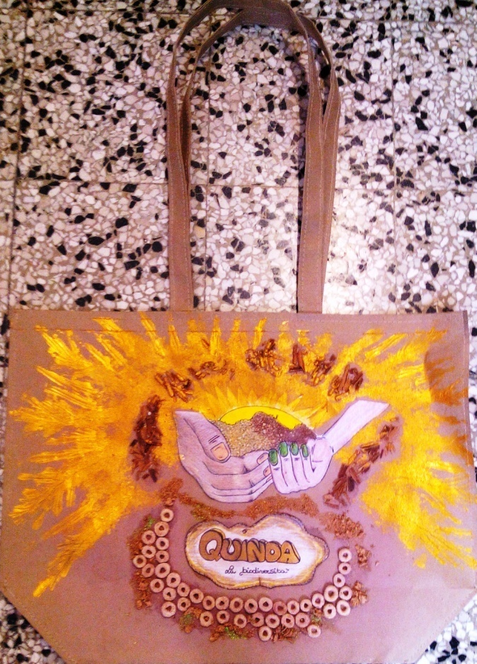
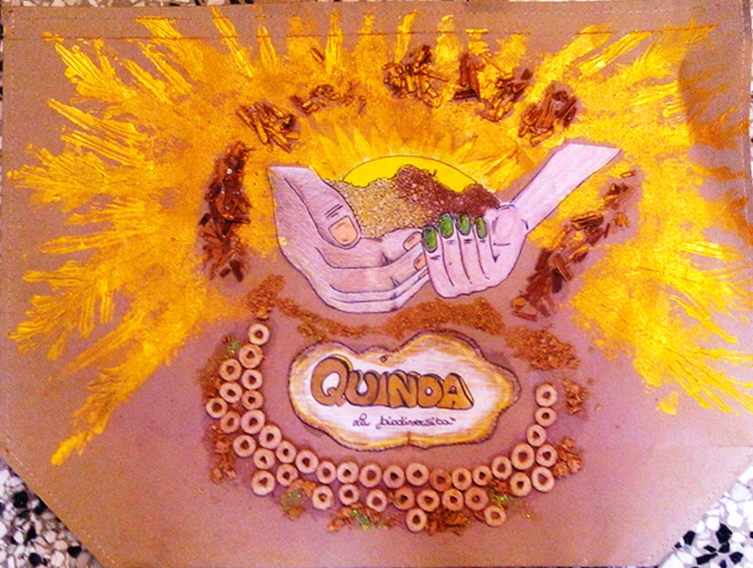

BAG?OUR
SHOPPER

Slide 33
3^{A} E STUDENTS
ALLMUCA A. CHIARA
ARIOLI AURORA
BEN SALEM IHEB
CALAMAI FEDERICA
CARONES GIAMMARCO
CICCARELLI VALERIO
CONTE LORENZO
D’AMATO ROSALBA
FALCONE ERIKA
FRASCA ANDREA
GAROFOLO G. EDOARDO
IAVARAZZO F. SWAMI
IORIO RICCARDO
LAGANA’ NICOLO’
LUCHI SERENA
MASTROFINI LORENZO
PERUCCI EMANUELE
RENDA ELISA
RICCI M. TERESA
SALTINI FABRIZIO
SEPE ELENA
SOLDATI LUDOVICA
TAURELLI GAIA
VONA VALERIO
VUOLO MARCO

Slide 34
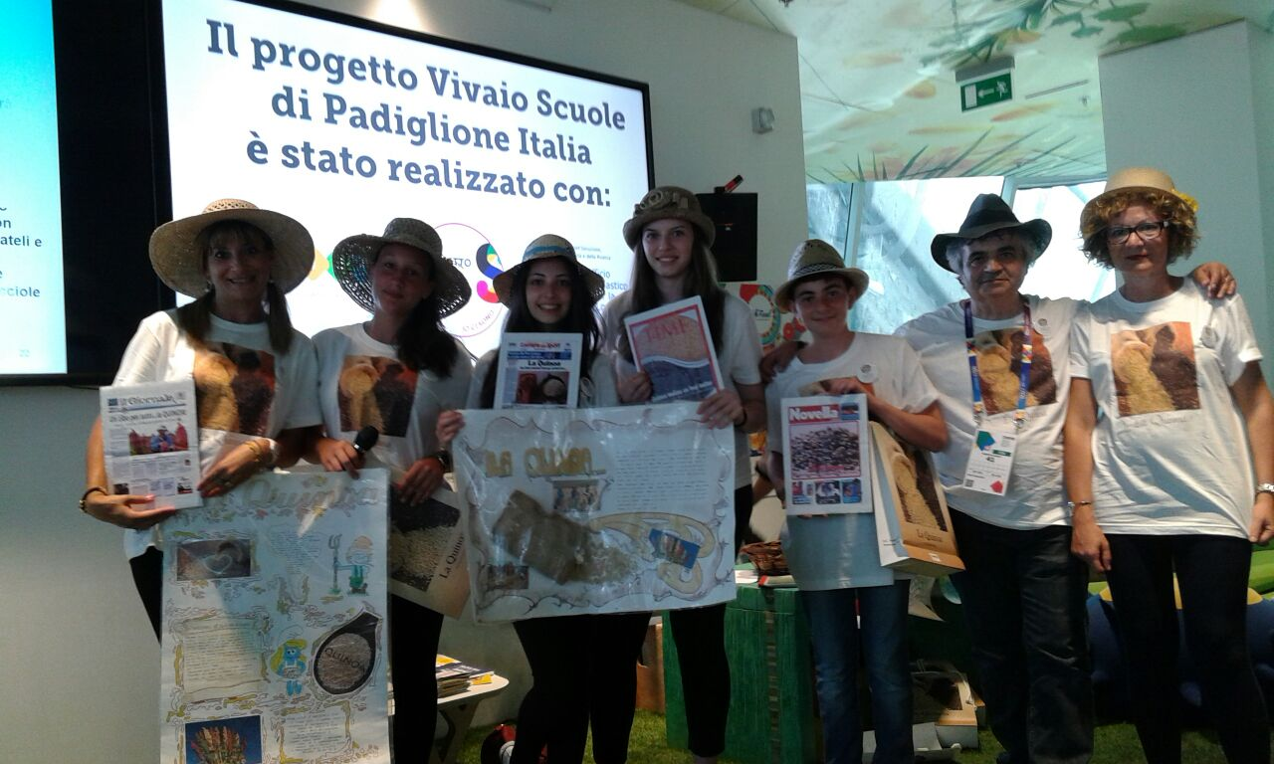

Slide 35
Thank you for your courtesy
Andean music, the author:Cecil Gonzalez

